Slide 1
A Clot in the lung that will not come out
EO O’Brien
Department of Anesthesilogy
UCSD

Slide 2
Case Presentation
64 M with a PMH s/f AHA Class D CHF (EF < 20%) on inotropic support on the floor was 5 days post-op from placement of an Impella 5.5 LVAD in the OR
In the ICU he became progressively hypoxemic with elevated airway pressures on the ventilator.
He has been intubated and ventilated since surgery with a 7.5 cuffed ETT. At the end of the case, a L. straight 28F chest tube was placed. This procedure was complicated by hemothorax from presumed tube penetration into lung parenchyma and ongoing hemoptysis. The chest tube had been removed.

Slide 3
CXR

Slide 4
Case Presentation
The patient had been receiving heparin through the purge channel in the Impella, but no other anti-coagulation until POD 4. The purge solution was changed to bicarbonate-based solution at that time.
The patient had received a total of 4u prbcs and 1 bag of platelets in the 2 days prior to the code.
He had received airway suctioning routinely since surgery, but it had slowed in the last 2 days.

Slide 5
Bronchoscopy Image
His gas exchange had been progressively deteriorating since the morning and in the afternoon, he was bronched and found to have a large clot at the carina completely obstructing his L mainstem bronchus and partially obstructing his R. mainstem bronchus.
His hypoxemia persisted and his airway pressure elevated….

Slide 6
What was happening

Slide 7
What would you do?

Slide 8
Here’s Our List
Retrieve the clot via the bronchoscope?
Push the clot further into the L. mainstem bronchus?
Break-up the clot and retrieve the pieces?
Push the ETT to the R mainstem bronchus?
Extubate and re-intubate with larger ETT?
Fogarty balloon inflation and clot retrieval?
Endobronchial thrombolysis?
VV-ECMO (with an Impella)

Slide 9
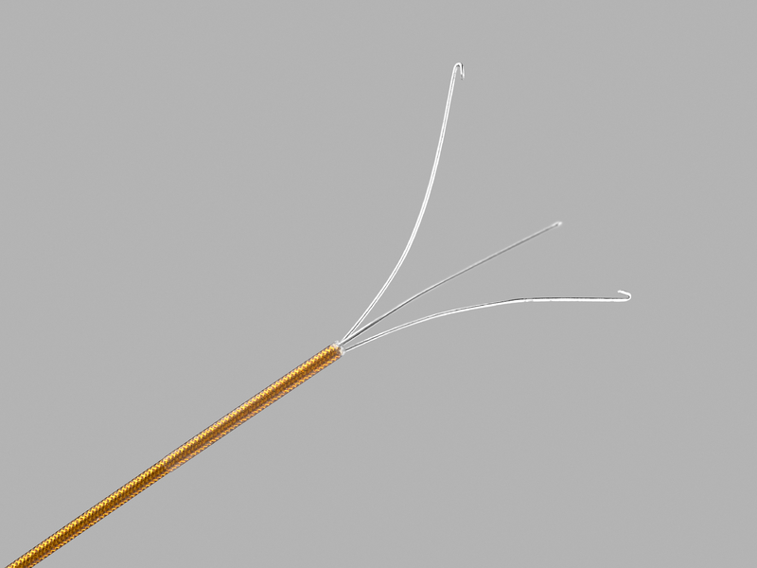
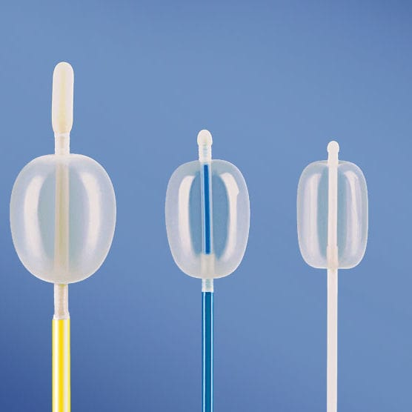
Bronchoscope Options

Slide 10
The Plan!

Slide 11
The Problem
Clot is easy to grasp.
Can be pulled up out of the bronchus.
Goes into but not through the ETT.
Can break off small pieces, but it still obstructs the left side.
Resident, fellow try for 1 hour.
Patient is still hypoxemic and pressor requirement is now very high.
We call Interventional Pulmonology (cryotherapy?) and CT surgery (ECMO).
Patient starts to code.

Slide 12
Stroke of Luck
Trying to push the clot into the R mainstem bronchus fails.
It doesn’t move, but the therapeutic scope penetrates the clot
Apply suction to the working channel of the scope and the clot gets sucked around the tip of the scope.
The clot shrinks under suction.
Able to pull the whole clot out through the ETT.
Able to ventilate both lungs and gas exchange improves

Slide 13
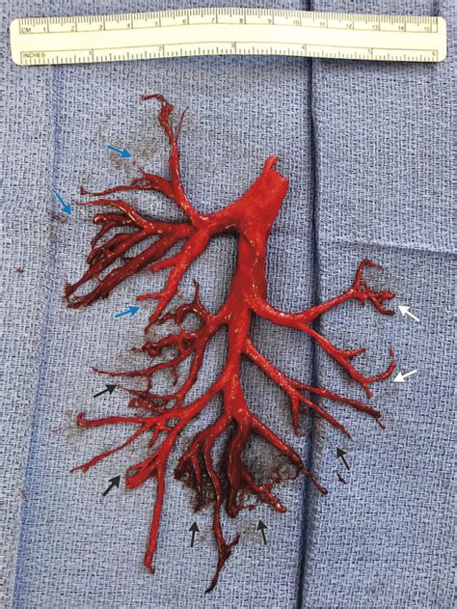
Some lessons
Endobronchial grasping forceps and baskets are designed to biopsy discreet endobronchial masses, not blood clots.
Large clots may be too big to maneuver a Fogerty catheter past.
Completely obstructed ventilation to one side of the lung will induce hypoxemic pulmonary vasoconstriction and can direct blood flow to the other lung.*
This burden may compromise the right heart and worsen LV filling.
*Afzelius P et. al. Abolished ventilation and perfusion of lung caused by blood clot in the left main bronchus: auto-downregulation of pulmonary arterial blood supply. BMJ Case Rep 2015. doi:10:1136/bcr-2015-209289

